Slide 1

Advance Functions

Slide 2
Topic
Function as an Object
Anonymous Function
External Function

Slide 3
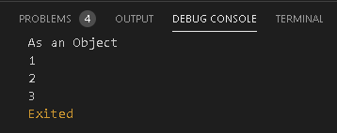
Function as an Object
void asObject(int i){
print(i);
}
void main() {
List<int> list=new List<int>();
list.add(1);
list.add(2);
list.add(3);
print("As an Object");
list.forEach(asObject); // (Everything in Dart is object)
}

Slide 4
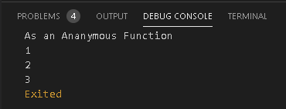
Anonymous Function
void main() {
List<int> list=new List<int>();
list.add(1);
list.add(2);
list.add(3);
print("As an Ananymous Function");
list.forEach((value){
print(value);
});
}

Slide 5
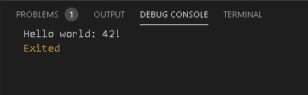
External Function
import 'package:newfun/newfun.dart' as newfun;
void main(List<String> arguments) {
print('Hello world: ${newfun.calculate()}!');
}
//function in file newfun.dart
int calculate() {
return 6 * 7;
}

Slide 6
Thank You

